Slide 2
Word Vectors

Slide 3
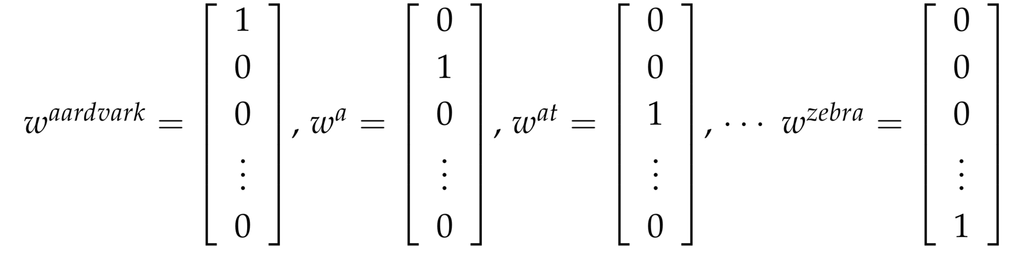
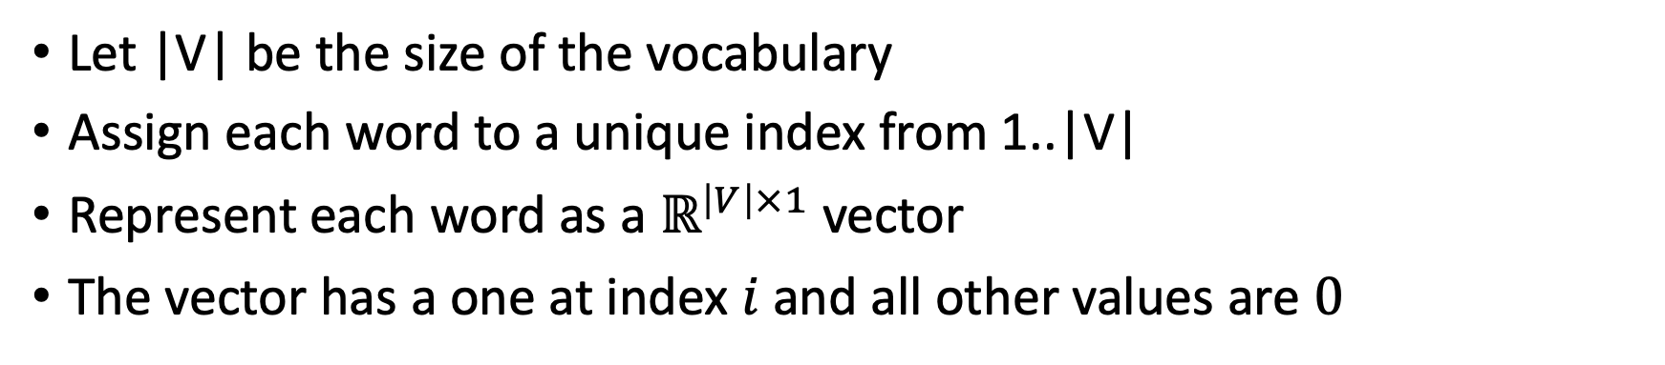
One-hot vectors
Let |V| be the size of the vocabulary
Assign each word to a unique index from 1..|V|
Represent each word as a $ℝ^{\left|V\right|×1}$ vector
The vector has a one at index $i$ and all other values are $0$

Slide 4
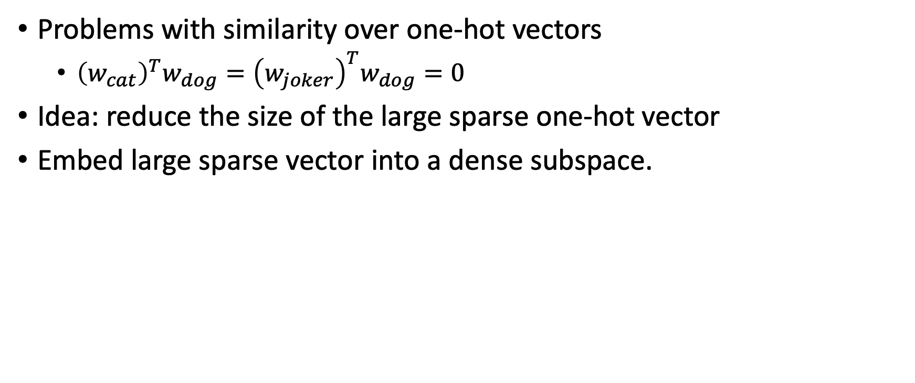
One-hot vectors
Problems with similarity over one-hot vectors
${\left(w_{cat}\right)}^{T}w_{dog}={\left(w_{joker}\right)}^{T}w_{dog}=0$
Idea: reduce the size of the large sparse one-hot vector
Embed large sparse vector into a dense subspace.

Slide 5
Singular Value Decomposition

Slide 6
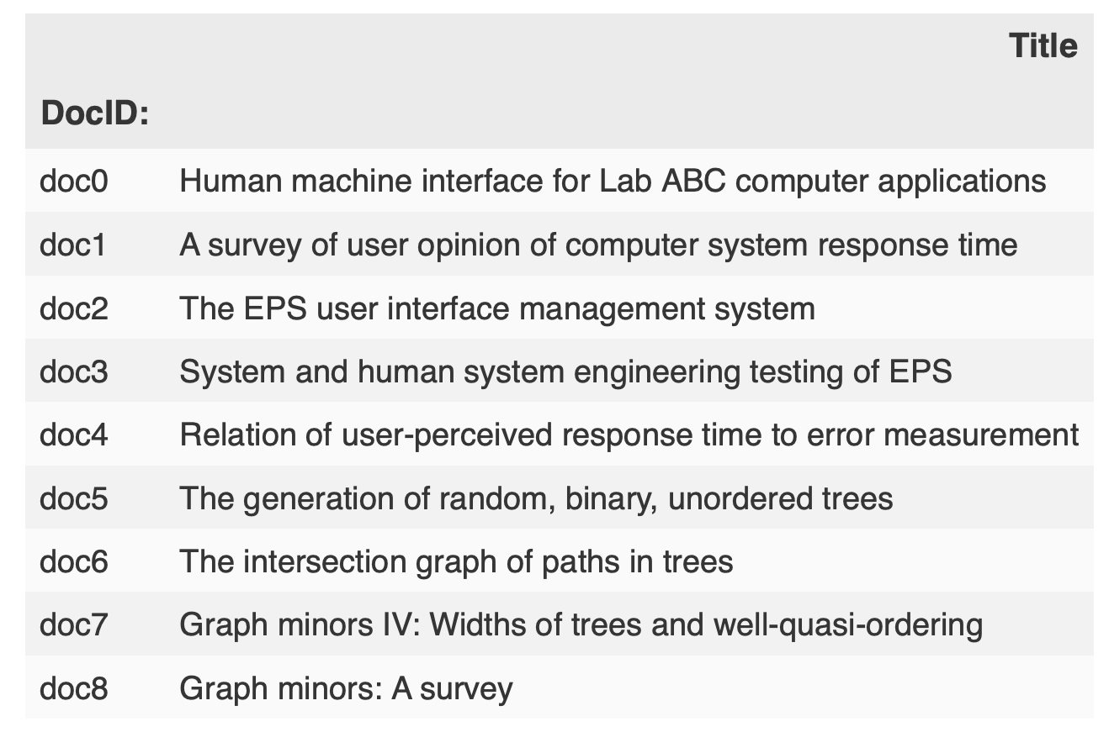
Window-based co-occurrence matrix

Slide 7
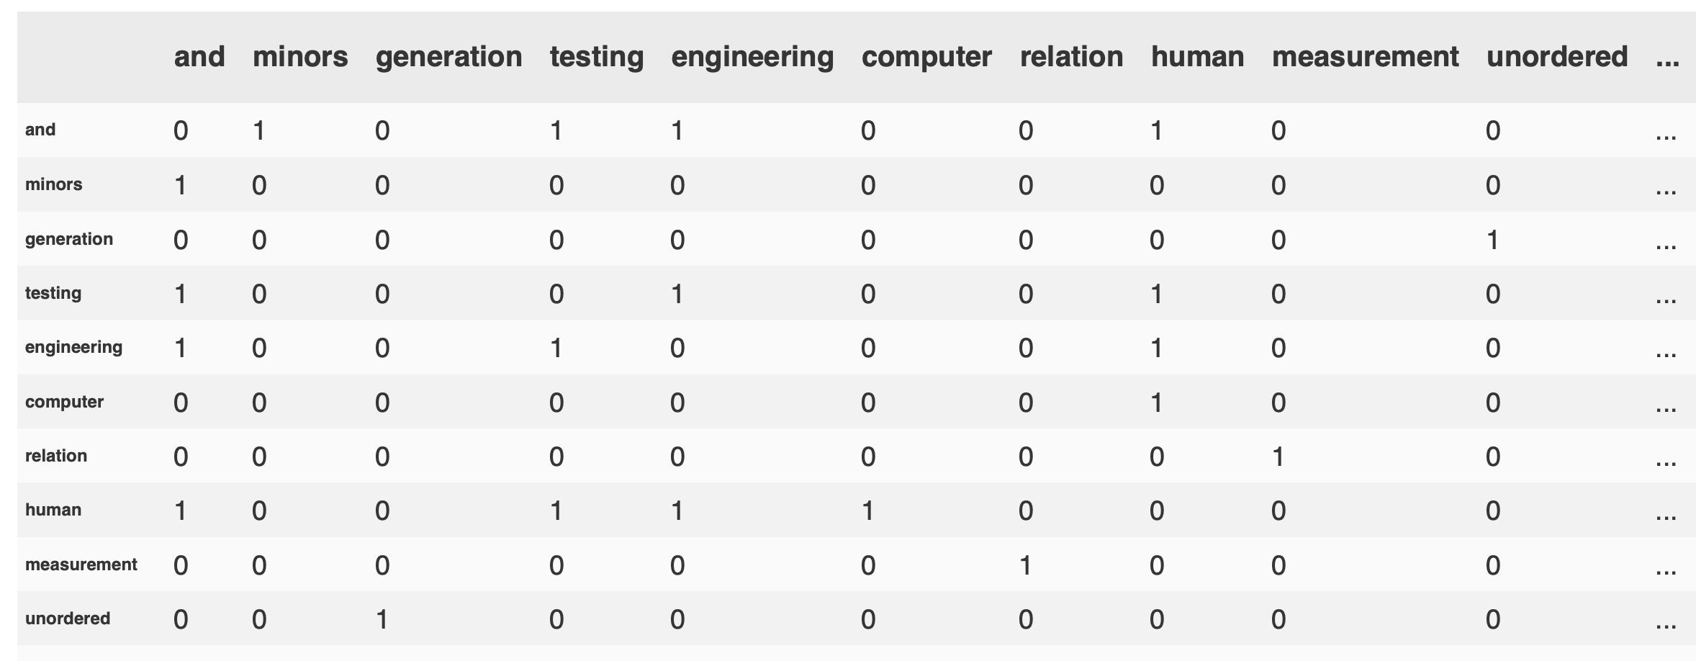
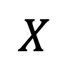
Window-based co-occurrence matrix
$$X$$

Slide 8
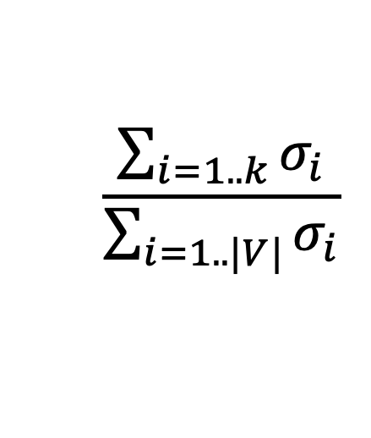
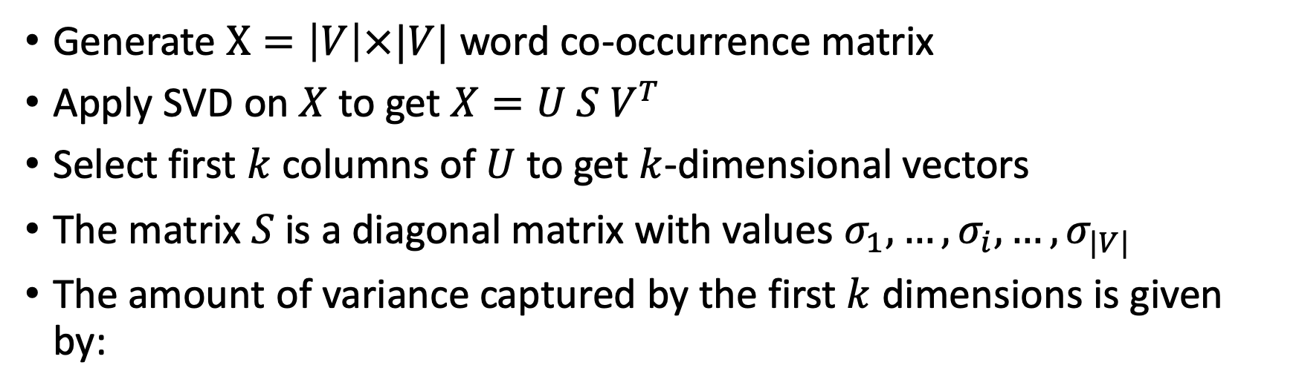
Singular Value Decomposition
Generate $X=\left|V\right|×|V|$ word co-occurrence matrix
Apply SVD on $X$ to get $X=U S V^{T}$
Select first $k$ columns of $U$ to get $k$-dimensional vectors
The matrix $S$ is a diagonal matrix with values $σ_{1}, …,{σ_{i}, …, σ}_{|V|}$
The amount of variance captured by the first $k$ dimensions is given by:
$$\frac{\sum_{i=1..k}{σ_{i}}}{\sum_{i=1..|V|}{σ_{i}}}$$

Slide 9
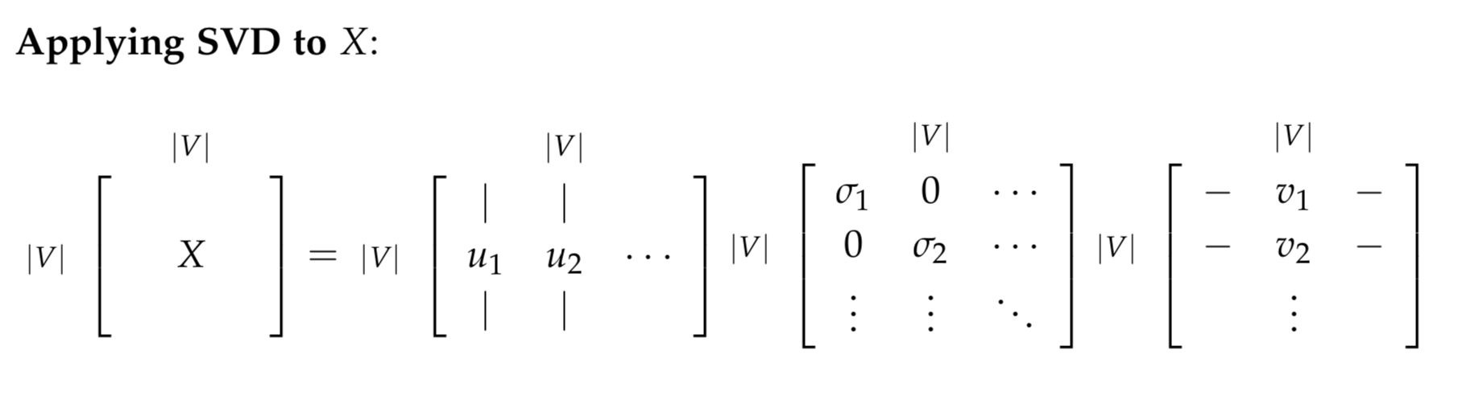
Dimensionality reduction using SVD

Slide 10
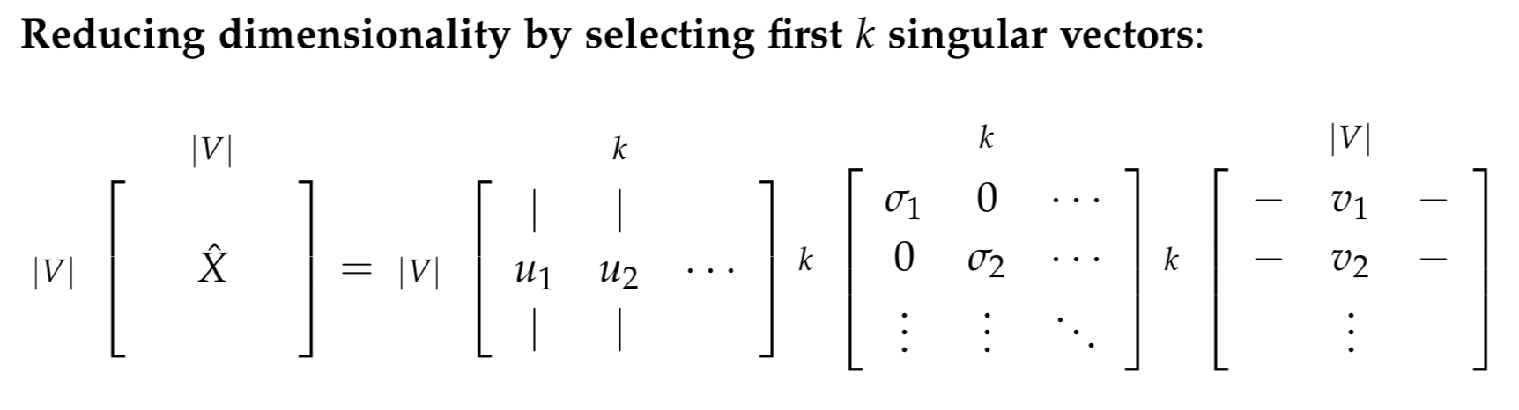
Dimensionality reduction using SVD

Slide 11
Word2Vec

Slide 12
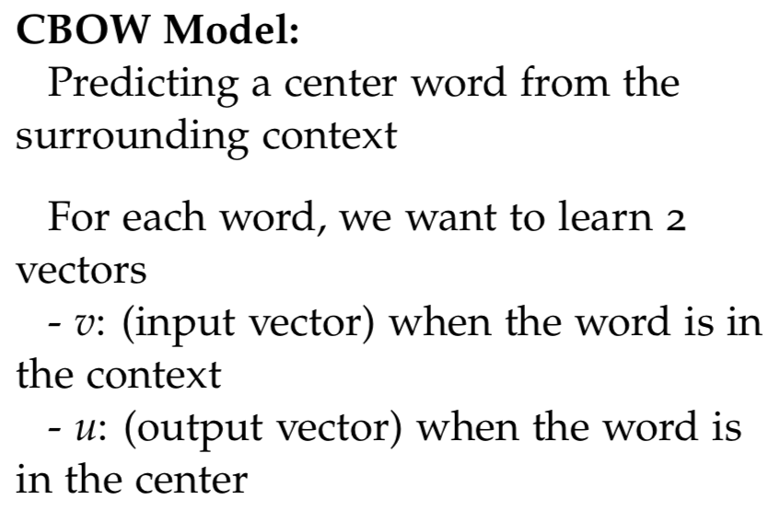
Word2vec: Continuous bag of words
<s>
the
cat
jumped
over
the
puddle

Slide 13
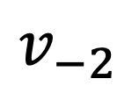
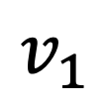
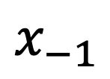
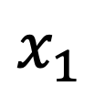
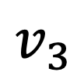
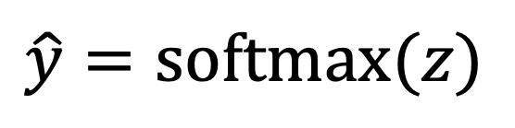
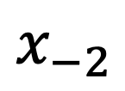
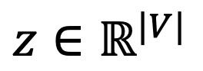
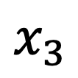
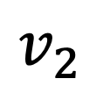
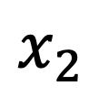
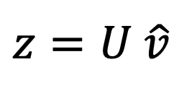
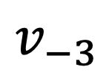
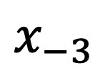
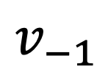

Word2vec: Continuous bag of words
<s>
the
cat
jumped
over
the
puddle
$$x_{−3}$$
$$x_{−2}$$
$$x_{−1}$$
$$x_{1}$$
$$x_{2}$$
$$x_{3}$$
One-hot vectors
$$v_{−3}$$
$$v_{−2}$$
$$v_{−1}$$
$$v_{1}$$
$$v_{2}$$
$$v_{3}$$
Word vectors
avg
$$z=U \hat{v}$$
$$\hat{v}$$
$$\hat{y}=\text{softmax}(z)$$
$$z∈ℝ^{|V|}$$
jumped

